Slide 1
Crypto Concepts, Classical Cipher, Number Sizes, Symmetric Cipher
CSC 481/681/781
Principles of Computer Security
Reference: Reading linked on class schedule

Slide 2
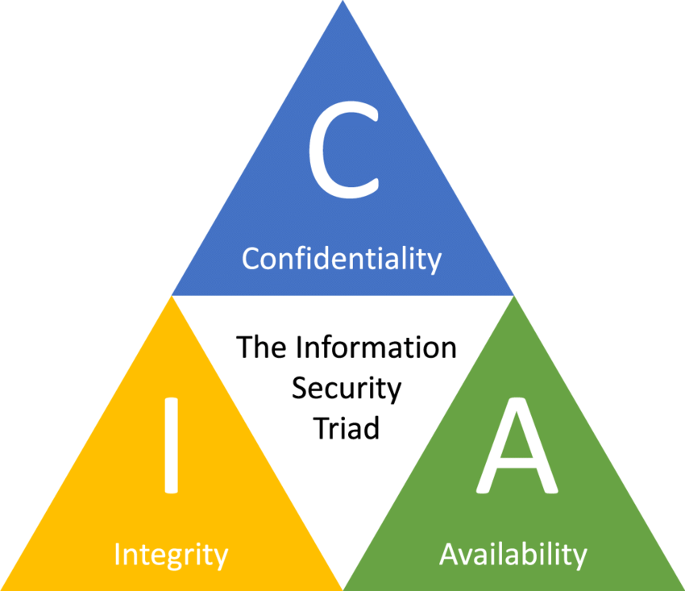
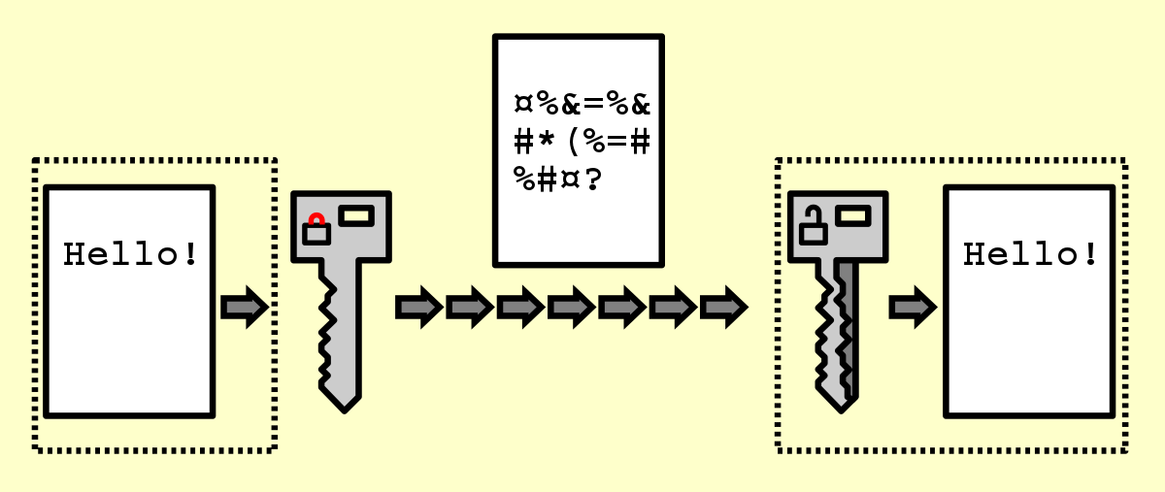
What Can Cryptography Do?
Consider “big three” computer security goals:
Confidentiality:
Uses encryption to transform plaintext into ciphertext.
Only those with the correct decryption key can recover the original message.

Slide 3
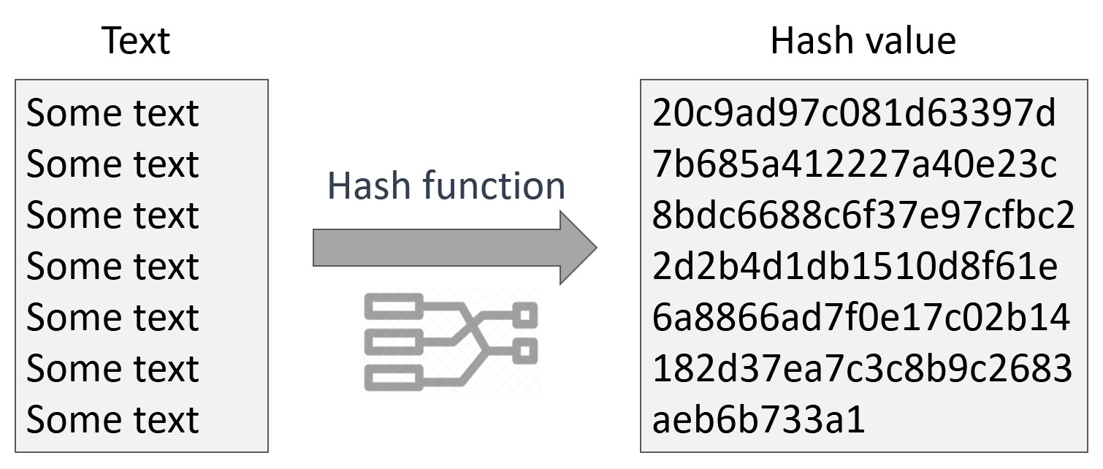
What Can Cryptography Do?
Consider “big three” computer security goals:
Integrity:
Uses hash-based message authentication codes (HMACs) to detect any change.
Even a one-bit change in the data produces a completely different hash value.

Slide 4
What Can Cryptography Do?
Consider “big three” computer security goals:
Availability (Indirectly):
Cryptography itself doesn’t create availability, but it supports it by ensuring that systems can securely run.

Slide 5
History of Cryptography
Ancient / Classical Cryptography
Permutation Cipher:
e.g., Scytale Cipher
Substitution Cipher:
e.g., Caesar Cipher (Single-table Substitution)
Vigenère Cipher (Polyalphabetic Substitution)
Relies on human operation

Slide 6
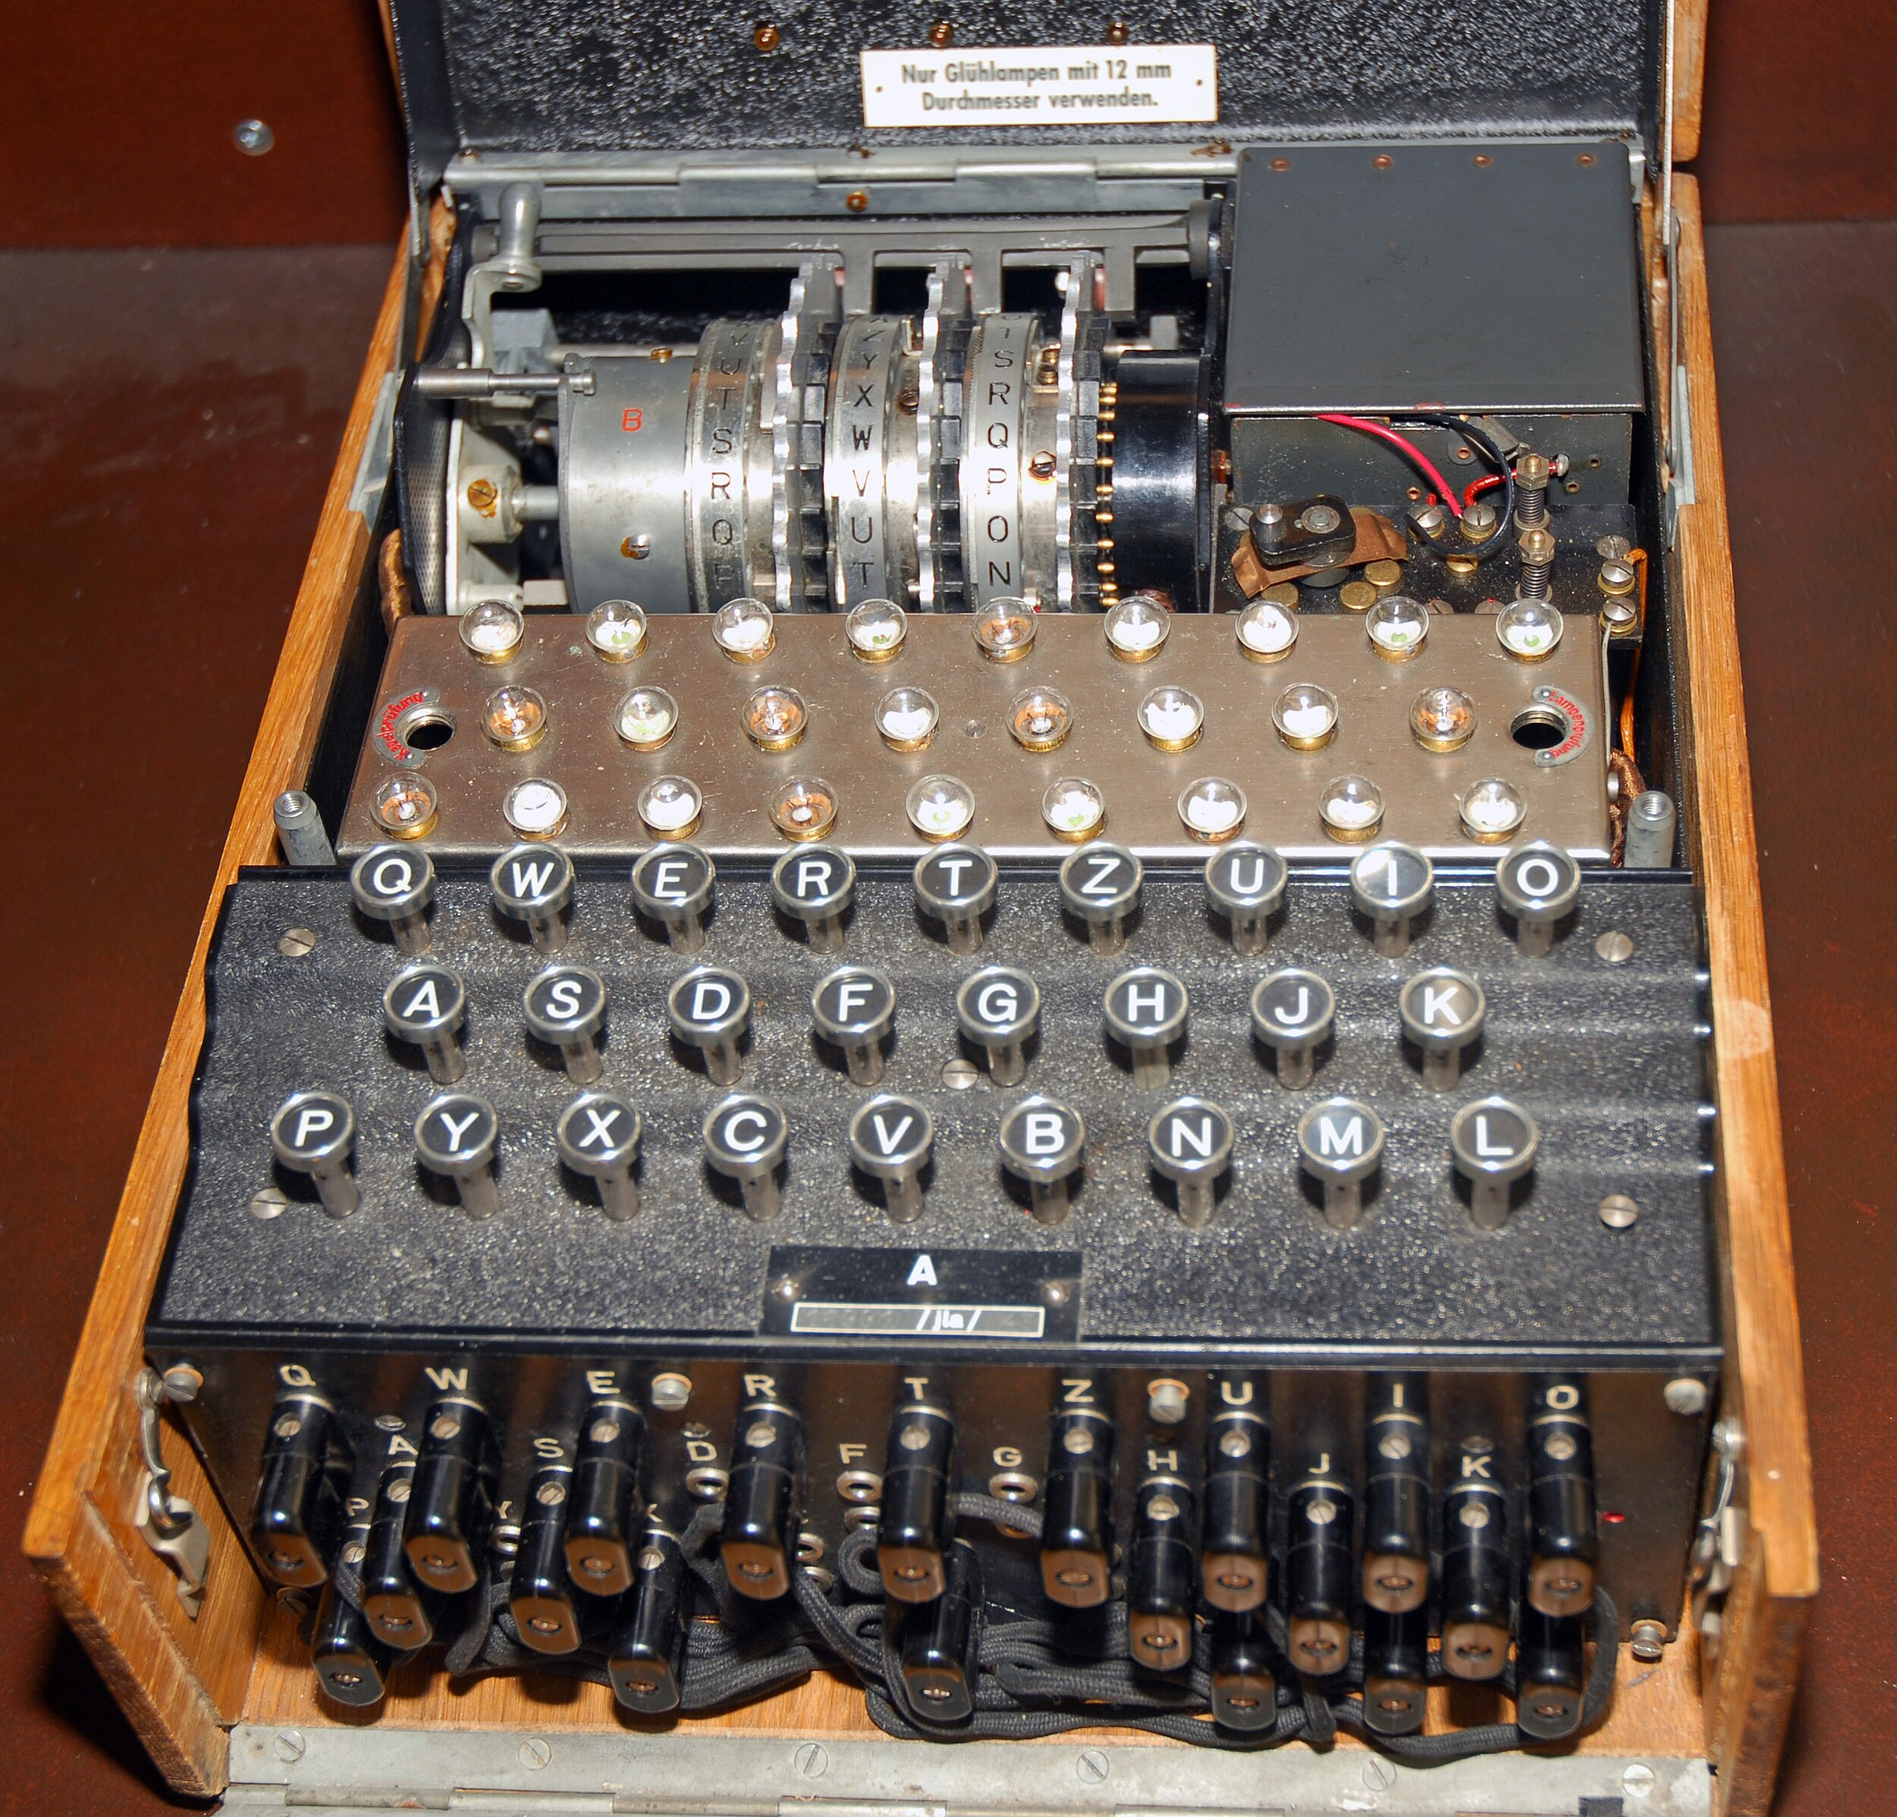
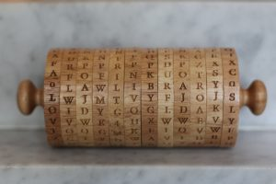
History of Cryptography
Medieval Cryptography (Pre-20th Century)
Enigma Machine
Jefferson Disk
Uses mechanical tools to automate encryption

Slide 7
History of Cryptography
Modern Cryptography (20th–21st Century)
Symmetric Encryption
Public-key Encryption
Hash Functions
Digital Signatures
Uses computers for fast, large-scale encryption

Slide 8
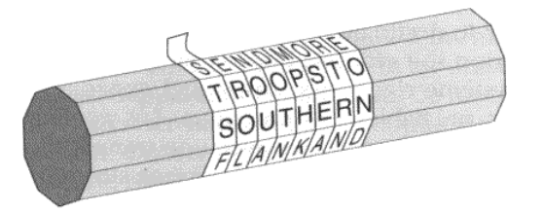
Permutation Cipher
Scytale Cipher
STSFEROLNOUADOTNMPHKOSEARTRNEOND
It seems like a meaningless sequence of characters after unfolding the stretch of leather!

Slide 9
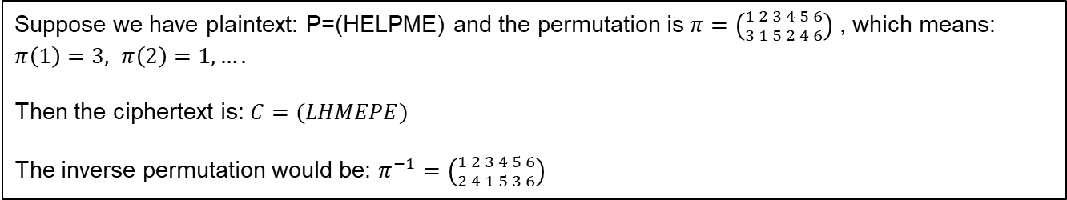
Permutation Cipher
Permutation Cipher doesn’t change the letters, it rearranges their positions according to a permutation.
Suppose we have plaintext: P=(HELPME) and the permutation is $π=\left({1 2 3 4 5 6 \atop 3 1 5 2 4 6}\right)$ , which means: $π\left(1\right)=3, π\left(2\right)=1, ….$
Then the ciphertext is: $C=(LHMEPE)$
The inverse permutation would be: $π^{−1}=\left({1 2 3 4 5 6 \atop 2 4 1 5 3 6}\right)$
Question: Can repeat a Permutation Cipher enhance security?
The composition of permutations is still just another single new permutation.

Slide 10
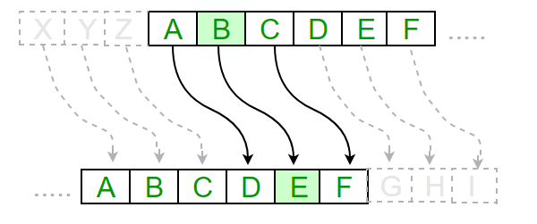
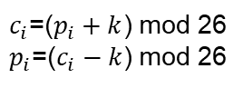
Substitution Cipher
Caesar Cipher (Single-table Substitution): One letter always be substituted by a fixed other letter.
We can represent each letter as a number: A=0, B=1, …, Z=25, $p_{i}$ is the $i$-th plaintext letter, $c_{i}$ is its corresponding ciphertext letter, $k$ is the shift number. $k=3$ in Caesar Cipher.
$c_{i}$=($p_{i}+k$) mod 26
$p_{i}$=($c_{i}−k$) mod 26
Plaintext: HELLO
Ciphertext: KHOOR
Notes:
Invented by Julius Caesar

Slide 11
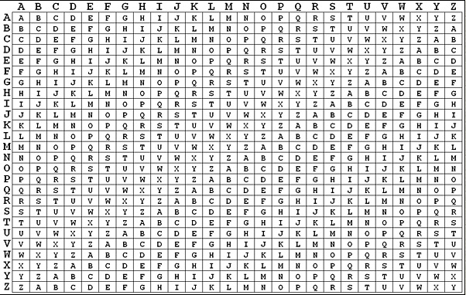
Substitution Cipher
Vigenère Cipher (Polyalphabetic Substitution): One letter can be substituted by multiple other letters.
Plaintext: I LOVE UNCG
Key: SPARTAN

Slide 12
Substitution Cipher
Vigenère Cipher (Polyalphabetic Substitution): One letter can be substituted by multiple other letters.
Plaintext:
I
L
O
V
E
U
N
C
G
Key:
S
P
A
R
T
A
N
S
P
Ciphertext:
A
O
M
X
U
A
U
V
A

Slide 13
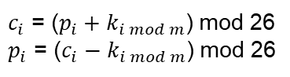
Substitution Cipher
Vigenère Cipher (Polyalphabetic Substitution): One letter can be substituted by multiple other letters.
For plaintext $P=(p_{1},…,p_{n})$, ciphertext $C=(c_{1},…,c_{n})$, keyword $K=\left(k_{1},…,k_{m}\right)$, repeat to match the plaintext length.
$c_{i}$ = ($p_{i}+k_{i mod m}$) mod 26
$p_{i}$ = ($c_{i}−k_{i mod m}$) mod 26

Slide 14
One-Time Pads
One-Time Pads (OTP): provide perfect secrecy, cannot be broken even with infinite computational power.
Take Vigenère Cipher as an example:
Plaintext: I LOVE UNCG I AM A STUDENT I MAJOR IN…
Key: SPARTANSPARTANSPARTAN…
Limited key reveals stronger statistical patterns in ciphertext, enabling attacks such as frequency analysis and known-plaintext recovery.

Slide 15
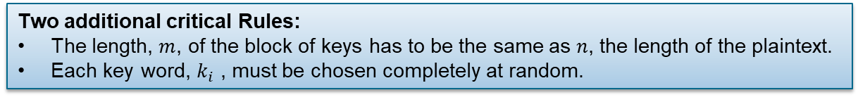
One-Time Pads
One-Time Pads (OTP): provide perfect secrecy, cannot be broken even with infinite computational power.
For plaintext $P=(p_{1},…,p_{n})$, ciphertext $C=(c_{1},…,c_{n})$, keyword $K=\left(k_{1},…,k_{m}\right)$, repeat to match the plaintext length.
$c_{i}$ = ($p_{i}+k_{i mod m}$) mod 26
$p_{i}$ = ($c_{i}−k_{i mod m}$) mod 26
Two additional critical Rules:
The length, $m$, of the block of keys has to be the same as $n$, the length of the plaintext.
Each key word, $k_{i}$ , must be chosen completely at random.

Slide 16
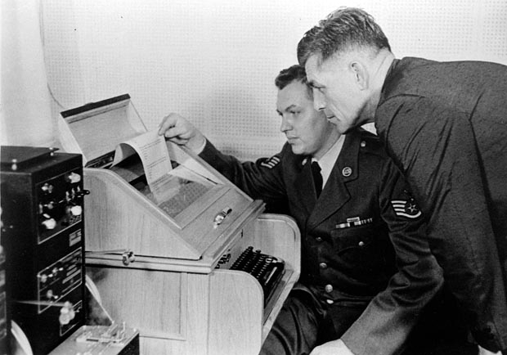
One-Time Pads
One-Time Pads (OTP): provide perfect secrecy, cannot be broken even with infinite computational power.
The hotline connecting Moscow and Washington, D.C., during the Cold War was encrypted using a one-time pad.

Slide 17
One-Time Pads
Why one-time pad cannot always be used?
The key must be truly random, not pseudo-random.
Generating long truly random at large scale is difficult.
It’s hard to distribute (synchronize) and manage (storage) the keys.
Modern system needs fast and repeated encryption with short keys.
Computational security is efficiency and strong enough in practice.

Slide 18
Enigma Machine
Enigma machine (Polyalphabetic Substitution): A rotor-based encryption machine used by Germany in WWII to encode military messages.
Rotors: permutation mechanism to shift letters differently on each key press.
Lampboad: Shows the encrypted output.
Plugboard: additional permutation mechanism to swap pairs of letters.
Keyboard: Enters the plaintext.

Slide 19
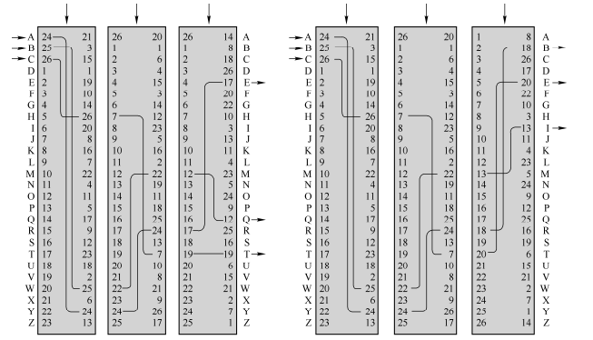
Enigma Machine
Enigma machine (Polyalphabetic Substitution): A rotor-based encryption machine used by Germany in WWII to encode military messages.
Slow
Middle
Fast
Slow
Middle
Fast

Slide 20
Attacks
Threat Model: is a process by which potential threats, such as structural vulnerabilities or the absence of appropriate safeguards, can be identified and enumerated, and countermeasures prioritized. - Wikipedia
A Threat Model answers:
Who the attacker is
What the attacker can do (capabilities)
What the attacker wants to achieve (goals)

Slide 21

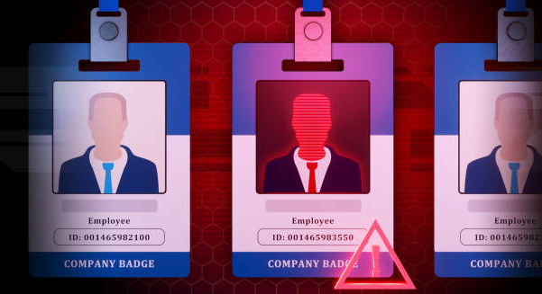
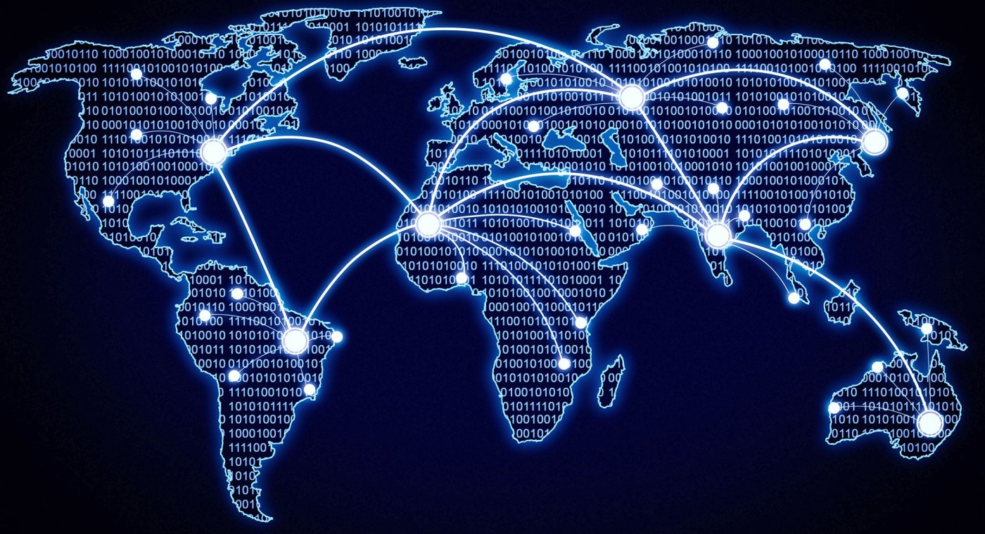
Attacks
Everyone can be an attacker:
A hacker on the Internet..
A dishonest insider in a company…
A foreign agency during wartime…
…
Who the attacker is

Slide 22
Attacks
What the attacker can do (capabilities)
Common Attacker Capabilities:
Ciphertext-Only Attack (COA)
Known-Plaintext Attack (KPA)
Chosen-Plaintext Attack (CPA)
Chosen-Ciphertext Attack (CCA)
Attackers often here
Increasing
Attacker
Power
Design for this

Slide 23

Attacks
Ciphertext-Only Attack (COA)
Example: An adversary captures encrypted HTTPS packets on a public Wi-Fi network. They only have ciphertexts from many sessions.
What can an attacker do: passively observe encrypted text and perform statistical analysis to guess plaintext.

Slide 24
Attacks
Known-Plaintext Attack (KPA)
Example: An attacker obtains a leaked company memo (plaintext) and the encrypted file previously sent over email (ciphertext).
What can an attacker do: recover the key that helps decrypt other ciphertexts.

Slide 25
Attacks
Chosen-Plaintext Attack (CPA)
Example: A cloud service offers an “encrypt” API for testing. An attacker submits crafted plaintexts and receives ciphertexts.
What can an attacker do: use chosen inputs to reveal the key and then decrypt or forge other ciphertexts.

Slide 26
Attacks
Chosen-Ciphertext Attack (CCA)
Example: A web application accepts an encrypted session token from clients and tries to decrypt it. If decryption fails due to bad padding, the server responds with an error message or a slightly different HTTP response.
What can an attacker do: sends the modified ciphertexts to the server. By observing responses to different modifications, the attacker recovers plaintexts or craft valid ciphertexts.

Slide 27
Attacks
The attacker’s objective:
Recover the secret message (Confidentiality).
Modify data without detection (Integrity).
Make the system unavailable (Availability).
What the attacker wants to achieve (goals)

Slide 28
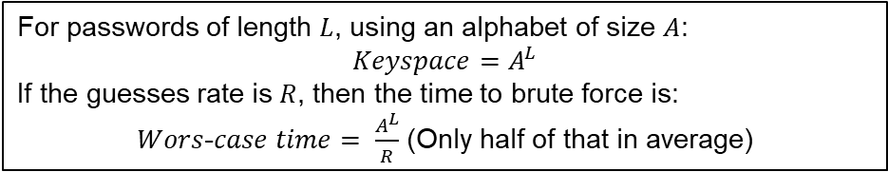
Brute Force
Brute Force: A brute-force attack tries every possible key or password until one works.
For passwords of length $L$, using an alphabet of size $A$:
$$Keyspace=A^{L}$$
If the guesses rate is $R$, then the time to brute force is:
$Wors$-$case time= \frac{A^{L}}{R}$ (Only half of that in average)
Question: Assume that $R={10}^{9}$ for a large GPU cluster and Alphabet size $A$=26. How long can an 8-lowercase key be brute forced?

Slide 29
Brute Force
Question: Assume that $R={10}^{9}$ for a large GPU cluster and Alphabet size $A$=26. How long can an 8-lowercase key be brute forced?
$Time= \frac{{26}^{8}}{{10}^{9}}$= 208.827064576 seconds $≈$ 3.48 minutes (worst-case)
8 lowercase characters is easily breakable by modern hardware.

Slide 30
Brute Force
Assume that $R={10}^{12}$ and Alphabet size $A≈95 (ASCII)$. How long can a 12-lowercase key be brute forced?
$Time= \frac{{95}^{12}}{{10}^{12}}≈3.26×{10}^{11}$seconds $≈$ 10338 years (worst-case)
Achieved computational security for modern hardware

Slide 31
Number Sizes
Estimating with powers of two
Important values for all CS majors to know cold:
2¹⁰ is “about 1000” (actually 1024)
2²⁰ is “about a million” (actually 1,048,576)
2³⁰ is “about a billion”
2⁴⁰ is “about a trillion”
…
And the converse for dealing with base 2 logarithms:
log₂(1000) is about 10
log₂(1,000,000) is about 20
log₂(1,000,000,000) is about 30
...

Slide 32
Number Sizes
Using for quick estimates - crypto example
Consider a “key cracking” machine that is clocked at 1 GHz, so can test 1 billion keys per second.
Attacking a cipher with 40-bit keys.
Question: How long to test all possible keys?
A billion keys/second is about 2³⁰ keys/second
There are 2⁴⁰ different 40-bit keys - try them all in the worst case
Worst-case time required is 2⁴⁰ / 2³⁰ = 2¹⁰ seconds
2¹⁰ seconds is about 1,000 seconds
An hour has 3,600 seconds, so this is just a little over 15 minutes (not a very secure cipher!)
Even worse: On average, only half of the keyspace needs to be explored, so this is broken in 2⁹ = 512 seconds (< 9 min) on average

Slide 33
Number Sizes
More precise estimates
Know powers of 2 up to 2¹⁰ - a few important ones:
2⁴ = 16
2⁵ = 32
2⁸ = 256
Examples:
What is 2²⁵? 2²⁰∙2⁵ = approx 32 million
What is 2³⁸? 2³⁰∙2⁸ = approx 256 billion
Relation to a few other measures:
One hour is 3,600 seconds, which is approx 2¹²
One day is 86,400, which is approx 2¹⁶ (closer: 2^{16.4})
One year is approx 2²⁵ seconds
So, 8 trillion cycles on a 1GHz machine takes:
2⁴³ / 2³⁰ = 2¹³ seconds → about 2 hours

Slide 34
Keysizes
Back to our original question
Question: Given a baseline of 1 billion tests/second, how big does the keyspace need to be for brute force to be impractical?
What does “impractical” mean?
Let’s say “over 8 years to break on average” - can you answer the question?

Slide 35
Keysizes
Back to our original question
Question: Given a baseline of 1 billion tests/second, how big does the keyspace need to be for brute force to be impractical?
What does “impractical” mean?
Let’s say “over 8 years to break on average” - can you answer the question?
8 years is 2³∙2²⁵ = 2²⁸ seconds
1 billion keys tested every second → 2³⁰∙2²⁸ = 2⁵⁸ keys tested in 8 years
For “on average”, keyspace needs to be twice this: |K | ≥ 2⁵⁹
So: Need to use keys with at least 59 bits

Slide 36
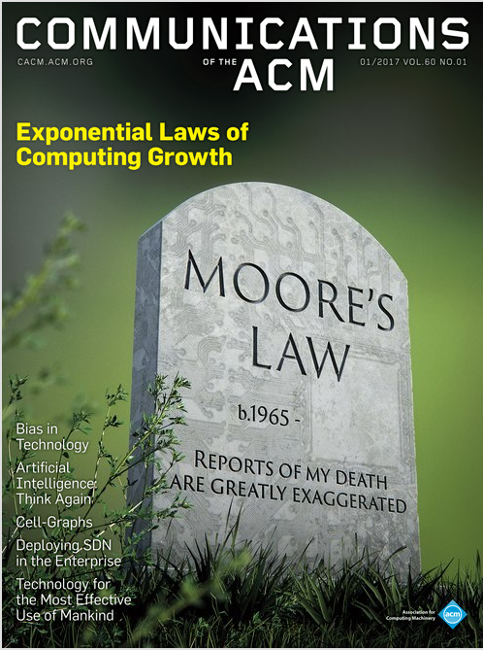
Number Sizes - Machines Get Faster!
Moore’s Law
Moore’s Law states that computing power doubles approximately every 18 months (1.5 years).
Example use:
9 years from now, we will have had 6 “doublings”, so computing power will be 2⁶ = 64 times faster than today.
Can this continue indefinitely?
No.
Have we reached the end of Moore’s Law?
Opinions vary....

Slide 37
Symmetric Ciphers
Most common type of symmetric cipher: Block cipher
DES (Data Encryption Standard) : adopted in the 1970s (based on a Feistel network). Widely used in the 1980s–90s;
AES (Advanced Encryption Standard) : selected in 2000 to replace DES, based on a substitution–permutation network (Rijndael).

Slide 38
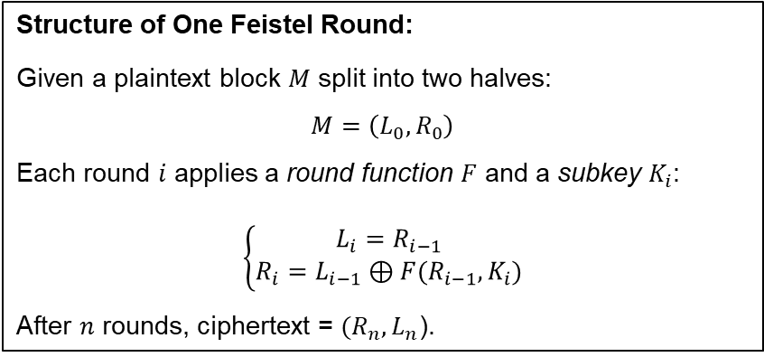
Symmetric Ciphers
Most common type of symmetric cipher: Block cipher
Feistel network
Structure of One Feistel Round:
Given a plaintext block $M$ split into two halves:
$$M=\left(L_{0},R_{0}\right)$$
Each round $i$ applies a round function $F$ and a subkey $K_{i}$:
$$\left\{\begin{aligned}L_{i}=R_{i−1} \\ R_{i}=L_{i−1}⊕F(R_{i−1},K_{i})\end{aligned}\right.$$
After $n$ rounds, ciphertext = $(R_{n},L_{n}$).

Slide 39
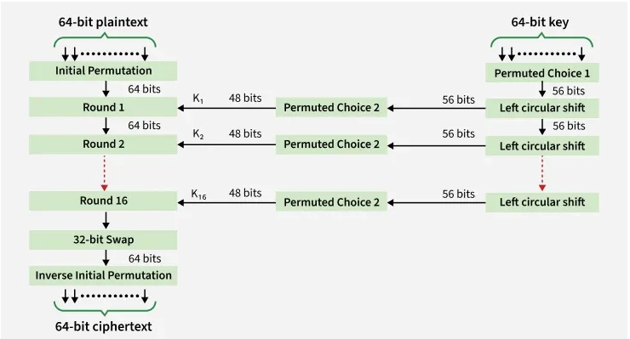
Symmetric Ciphers
Most common type of symmetric cipher: Block cipher
Details of DES

Slide 40
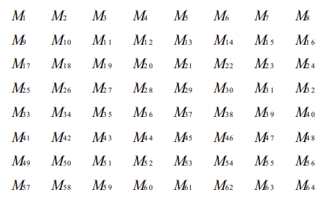
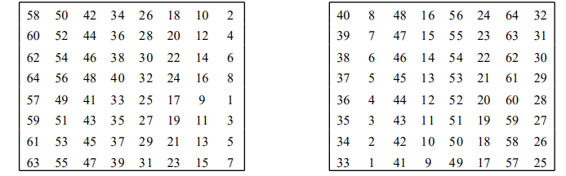
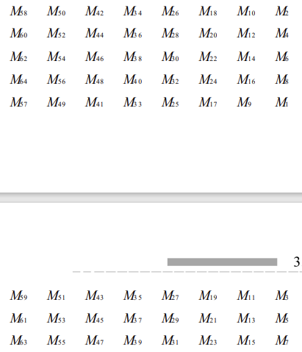
Symmetric Ciphers
Most common type of symmetric cipher: Block cipher
Details of DES
64 bits plaintext
Initial Permutation:
Initial Permutation Table
Inverse Initial Permutation
Permutated plaintext

Slide 41
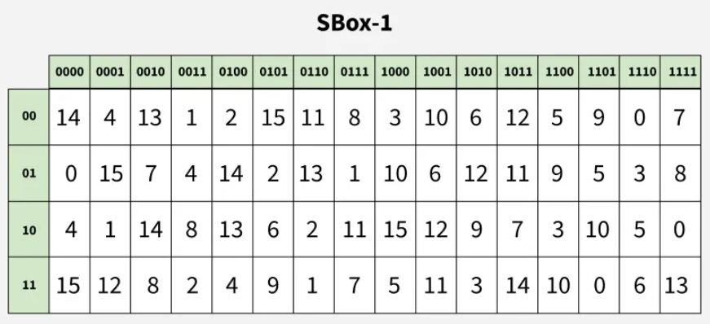
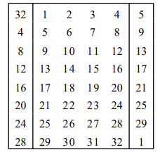
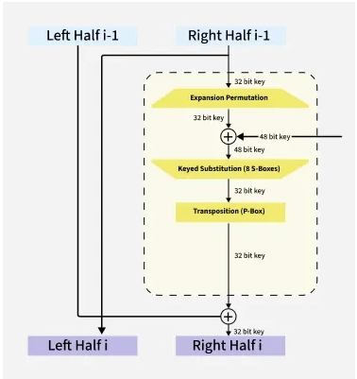
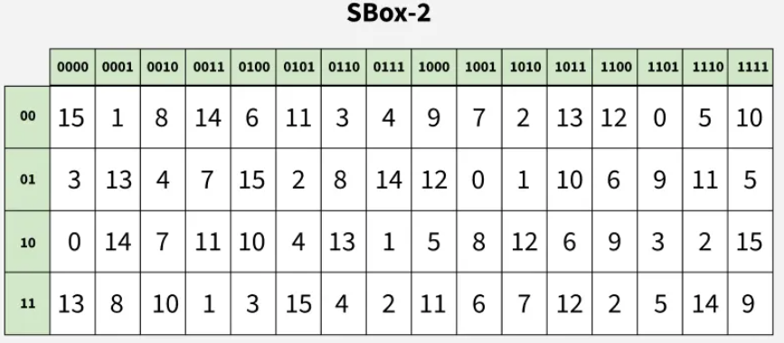
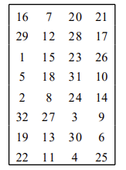
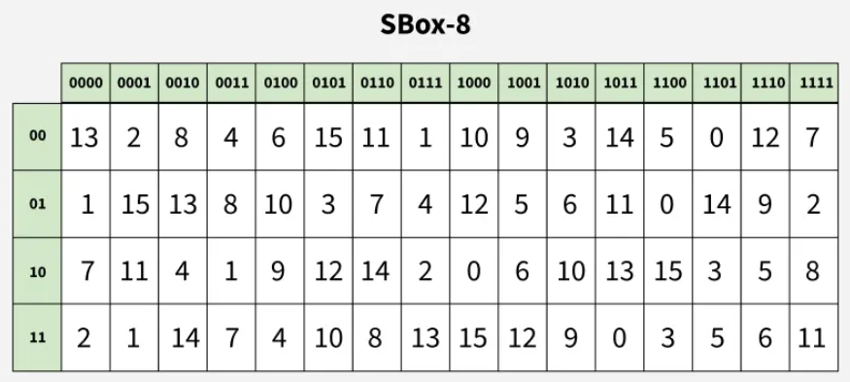
Symmetric Ciphers
Most common type of symmetric cipher: Block cipher
Details of DES
E-Box Expansion Table
32 bits
32 bits
48 bits
P-Box Permutation Table
…

Slide 42
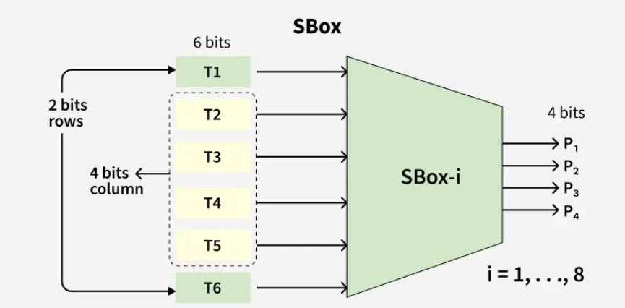
Symmetric Ciphers
Most common type of symmetric cipher: Block cipher
Details of DES
48-bit block is split into eight chunks of 6-bit size each.
Example: 011001
48 bits
32 bits

Slide 43
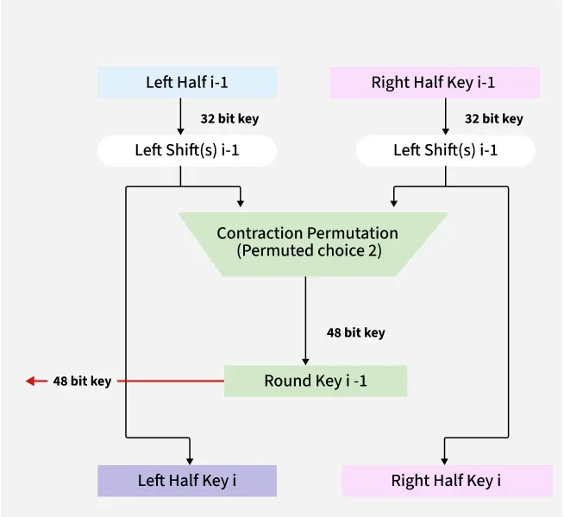
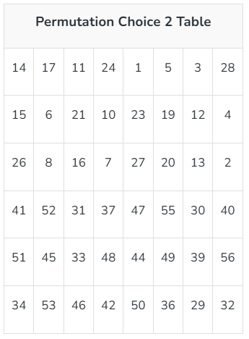
Symmetric Ciphers
Most common type of symmetric cipher: Block cipher
Details of DES
Some bits are discarded
48 bits

Slide 44
Symmetric Ciphers
Most common type of symmetric cipher: Block cipher
# bits in input is “block size”
Properties of a block cipher
Must supply a full block of input bits in order to evaluate
Partial block? Use padding
More than one block? Use a cipher mode
Design parameters
Block size: Bits encrypted in one application
Key size:
K is the keyspace (set of possible keys)
Key is typically a k-bit binary string
So |K | = 2^{k}
Plaintext Input
01101 … 1101
Block
Cipher
Key
11010 ...0110
Ciphertext Output

Slide 45
Symmetric Ciphers
Most common type of symmetric cipher: Block cipher
Feature | DES | 3DES | AES
Block size | 64 bits | 64 bits | 128 bits
Key size | 56 bits | 112/168 bits (two/three-key) | 128, 192, 256 bits
Structure | Feistel network | Feistel (3× DES) | Substitution–Permutation Network
Rounds | 16 rounds | 48 (3×16) | 10 / 12 / 14 (for 128/192/256 keys)
Security | Broken / insufficient | Deprecated for new systems | Strong (widely recommended)

Slide 46
Key Size
Put all this together to answer: “Is 128 bits enough?”
2004 Estimate: $100k machine breaks 56-bit DES key in 6 hours
What about a 128-bit key?
$100k machine takes 2¹²⁸/2⁵⁶ = 2¹²⁸⁻⁵⁶ = 2⁷² times longer
Or 2⁷⁰ days, or >2⁶¹ years > 10¹⁸ years [the earth is <10¹⁰ years old]
What if we spent $100,000,000,000?
Would take >10¹² years
What about Moore’s law saying that in 20 years machines will be about 16,000 times faster? (“20 years after 2004” is … now!)
Would take >10⁸ years
OK, what about in 40 years (20 years from now: machines 100 million times faster)?
Would still take >10⁴=10,000 years
Do you really think Moore’s law will last this long?

Slide 47
Symmetric Ciphers
Most common type of symmetric cipher: Block cipher
Four modes introduced with DES standard in 1977
Electronic Codebook (ECB)
Cipher Block Chaining (CBC)
Cipher Feedback (CFB)
Output Feedback (OFB)
An additional mode introduced later (standardized with AES)
Counter (CTR)
Galois Counter Mode (GCM)
Each mode has tradeoffs in terms of flexibility, security, parallelizability, ...
Intuitive, but insecure (don’t use!)
OK for most applications
Seldom used (we won’t discuss)
Includes integrity protection too!

Slide 48
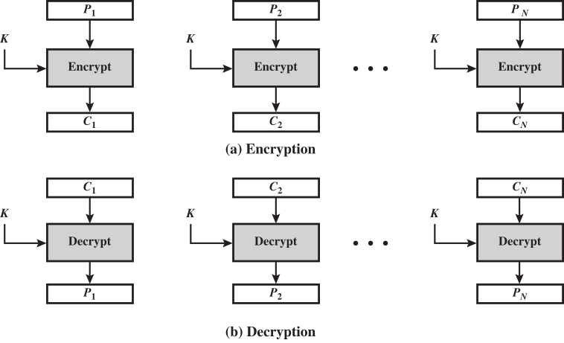
Symmetric Ciphers
Most common type of symmetric cipher: Block cipher
Electronic Codebook (ECB)
Identical plaintext blocks produce identical ciphertext blocks. For long messages with fixed structures, this can reveal patterns and make ECB insecure.

Slide 49

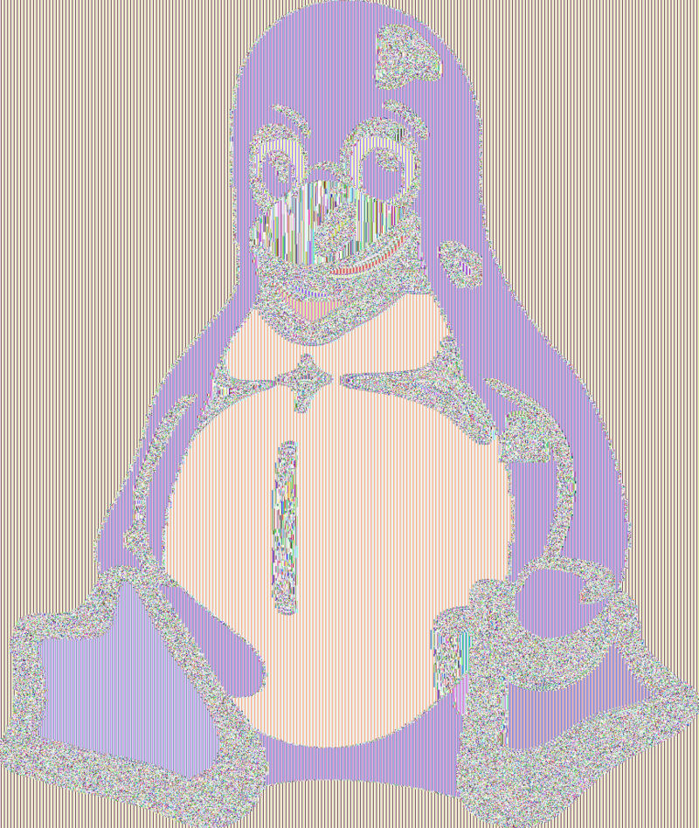
Symmetric Ciphers
Most common type of symmetric cipher: Block cipher
Electronic Codebook (ECB)
Original image
Using ECB allows patterns to be easily discerned
From the Wikipedia block cipher modes entry

Slide 50
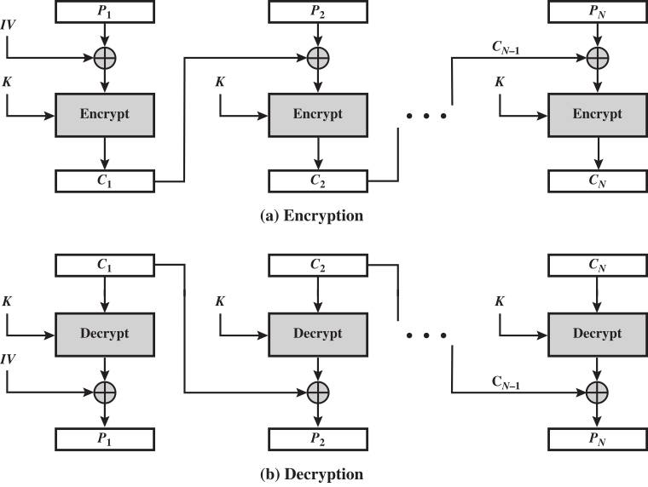
Symmetric Ciphers
Most common type of symmetric cipher: Block cipher
Cipher Block Chaining (CBC)
Initial vector IV must be random
Not sensitive
Transmit with ciphertext
Do not to repeat previous IV!!
Randomizes next block
Breaks up pattern
Changing block affects all following blocks
But: Can’t parallelize
CBC mode can also help with authentication.

Slide 51
Padding
Or: How to encrypt less than a block
ECB and CBC modes must encrypt full blocks of plaintext!
What if you have 192 bits of plaintext with AES/CBC? 128+64 bits
Technique 1 (bit padding):
No matter how long the plaintext, always append a 1 bit, followed by as many 0’s as needed to fill out block.
Example: 8-bit blocks, 10111010 110 becomes 10111010 11010000
Advantage: plaintext can be any number of bits
Question: Why “always append 1”? What if plaintext is already a multiple of block size?
Technique 2 (byte count padding - or PKCS#7 / PKCS#5):
Count how many bytes of padding needed (at least 1), say c
Add c bytes each with value c
Ex (32-bit blocks, hex): 42 1a 49 c3 21 becomes 42 1a 49 c3 21 03 03 03
Only works for padding full bytes! (Note: Used by Java Crypto Architecture)

Slide 52
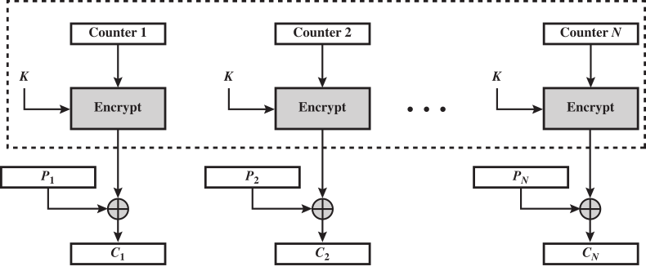
Symmetric Ciphers
Most common type of symmetric cipher: Block cipher
Counter (CTR) Mode
How to view this: XORing with “random noise”
Not really random, but looks like it! (if truly random, would be a “one-time pad”)
Happens bit-by-bit, so effectively turns AES into a stream cipher
CTR-mode weaknesses:
Attackers can flip bits as they wish - called “malleability” of the cipher
Can counteract this problem by including integrity protections (GCM!)
Reusing counter values is disastrous!!

Slide 53
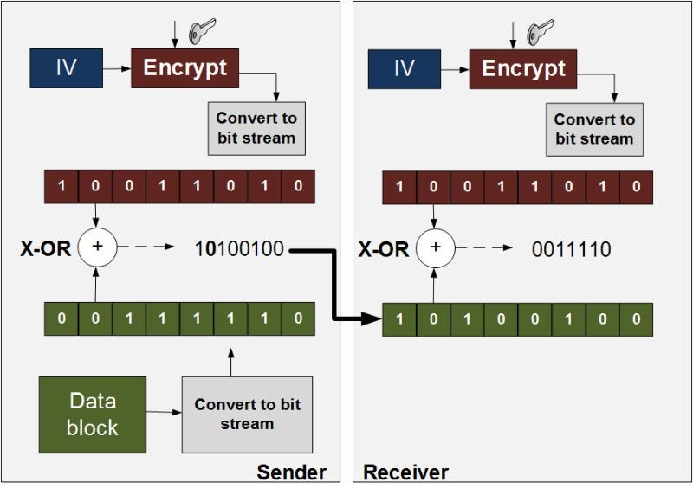
Symmetric Ciphers
Stream cipher
Counter (CTR) Mode
A key and initialization vector (IV) are input to a keystream generator.
The generator outputs a pseudo-random bit stream.
Each plaintext bit is XORed with the corresponding keystream bit.
RC4, A5/1, and ChaCha20…
No need for padding, but hard to guarantee randomness quality and Sensitive to bit loss.

